Slide 1
Asset
Certificate
Participant
University
Colleges
Transaction
requestAffiliation()
enrollCourse()
Events
Channel
Chaincode
DLedger – Registories
Network Permissions
Students
Verifier
[UniqueID, Issued To, Issues By, Date-Time, Subject, Stream, Valid From, Valid Upto, Status, college, EnrollmentID, MetaData]
enrollStudent()
issueCertificate()
verifyCertificate()
CertificateIssued
StudentEnrolled
Colleges
Students
Certificates
Historian
University – College
Simple:
College – College: Groups & Events
Complex:
Transaction Validation
Seach by Criteria
Details show in following Slide
searchCertificatesByID()

Slide 2
Transactions
requestAffiliation()
Input:
- College Detail
Output: Status
By Praticipant: college
On Praticipant: University
searchCertificateByID()
Input:
- National-ID / Enrollment-ID
Output: Certificate List
By Praticipant: Verifier
On Praticipant: Blockchain
enrollCourse()
Input:
- Course Detail
Output: CourseID
By Praticipant: College
On Praticipant: University
issueCertificate()
Input:
- Certificate Detail
Output: Public Address
By Praticipant: College
On Praticipant: University
verifyCertificate()
Input: Public Address
Output: Certifcate Details
By Praticipant: Verifier (anyone)
enrollStudent()
Input:
- Student Detail
Output: Student EnrollmentID
By Praticipant: College
On Praticipant: University
renewCertificate()
Input:
- Certificate Detail
Output: Status-Success/fail
By Praticipant: College
On Praticipant: University

Slide 3
2, 3b, 4
College
University
requestAffiliation()
enrollCourse()
enrollStudent()
issueCertificate()
verifyCertificate()
searchCertificatesByID()
1
BNA
3a
5, 6
Verifier
Students

Slide 4
Basic Story:
University: As a University, I am an intitution for higher studies. I want to affiliate Colleges and cources. Enroll Students and Award certificates
Students: As a student I want to take admissiom, enroll for a specific education program and get awarded with certification of successful completion
Colleges: As a college, I provide students specialized courses as per the guidelines/affiliation with university.
Verifier: As a verifier, I want to verify if the certificate ID (public address) is valid and its corressponding details (Issued to, Status, etc). I can also search all certificates assocaited with a Nation-ID (or tokenized ID)
Business Network Admin (BNA): As a network admin I want to deploy code and runtimes.

Slide 5
Business Application
Hyperledger Composer
Hyperledger Fabric - Blockchain
Node.js
(javascript)
Distributed
Processing

Slide 6
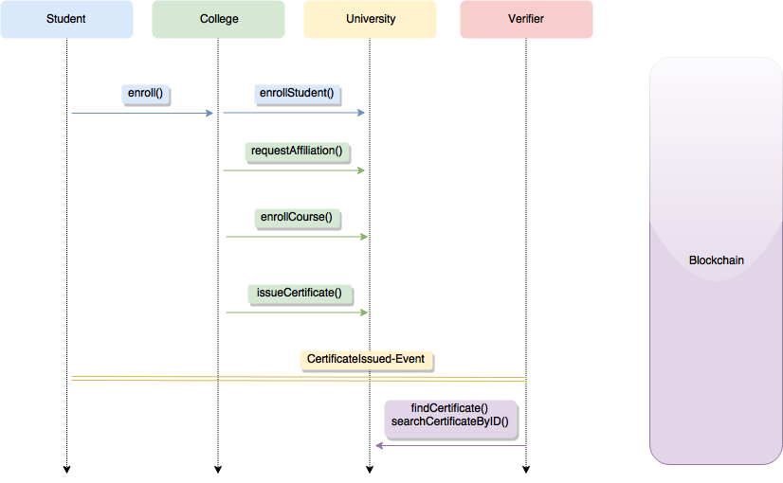

Slide 7
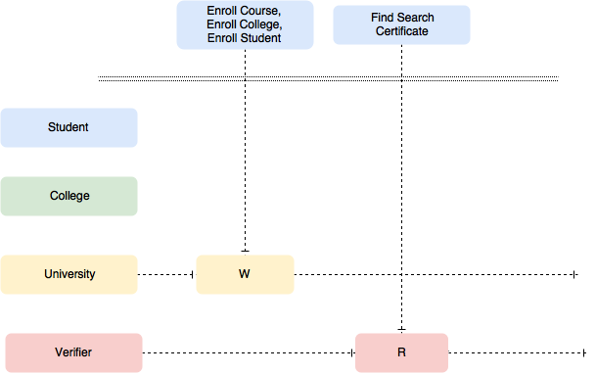

Slide 8
